Slide 1
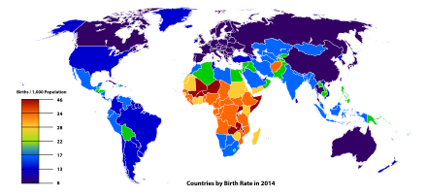
From Cradles to Growth: The Intersection of Fertility Rates and Economic Development
Author: Taiwo Adeyemi
Institution: Middle Tennessee State University, Murfreesboro, TN
Course: Econometrics I (ECON 6060)
Date: December 2023

Slide 2

Introduction and Abstract
Topic: Exploring the relationship between fertility rates and economic development
Purpose: To understand how declining fertility rates correlate with aspects of economic growth
Method: Analysis of international data, treating each country as a unique observation
Significance: Informing policies to address demographic changes in the context of global economic development

Slide 3

Literature Review
Paper 1 Summary: Human fertility in relation to education, economy, religion, contraception, and family planning
Paper 2 Summary: Trends in fertility rate and its relation to national wealth, life expectancy, and female education
Paper 3 Summary: Role of fertility and population in economic growth

Slide 4
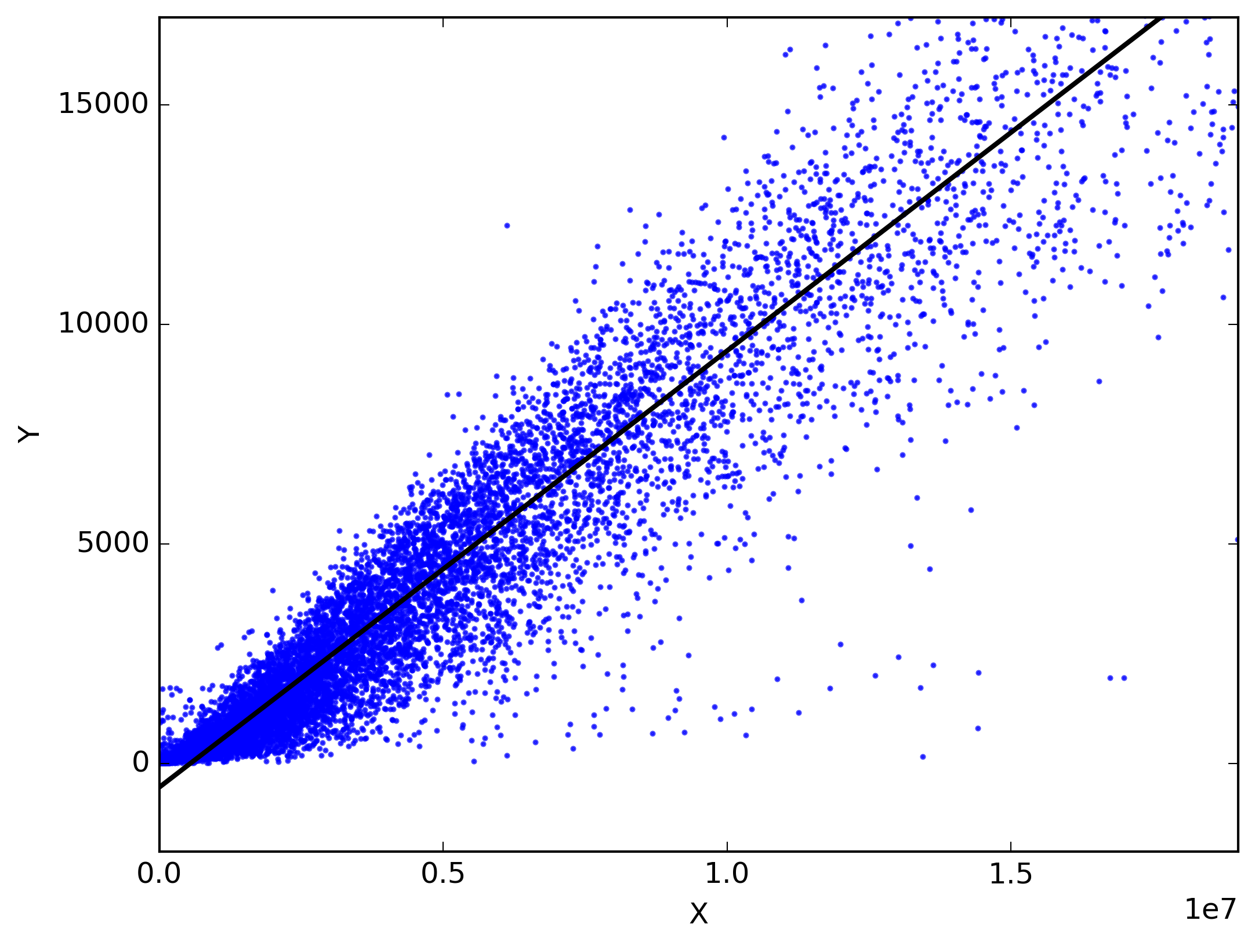
Methodology and Data
Data Sources: World Bank, UN DESA
Analytical Approach: Linear regression analysis, using R for data processing and model fitting
Model: TFR as a function of GDP per capita, female education, and contraceptive prevalence rate

Slide 5

Findings and Conclusion
Key Findings: Correlation between fertility rates and economic development, impact of education and contraceptive use
Implications: Need for balanced policies addressing education, healthcare, gender equality, and employment opportunities
Conclusion: Understanding and addressing the relationship between fertility rates and economic growth is crucial for sustainable development

